Slide 1
Data Analysis Project 1.
Predicting Stock Returns Using Machine Learning
Oct 27, 2024
Group Members: Kai Ren, WeiJie Zhang, Yang Lan, YiMing Jiang, Rui Hu

Slide 2
Data Analysis Framework
Component Stocks of CSI500
Collecting Dataset
Factor Engineering
Training Model
Backtesting
Daily & Min Trading
Data
Fundamental
Data
Macro
Data
Factors Importances Analysis
Daily Trading
Factors
Fundamental
Factors
Macro
Factors
Return
Labels
Factors Importance
Select & Normalize
Machine Learning Models 🔥
Adjustance for
Less Overfitting
MLP
LSTM
···
Conv
Trained Models ❄️
Future Return
Prediction
Market Actions
Backtesting
MLP
LSTM
···
Conv
Fig 1. The Framework of Data Analysis Project 1.

Slide 3
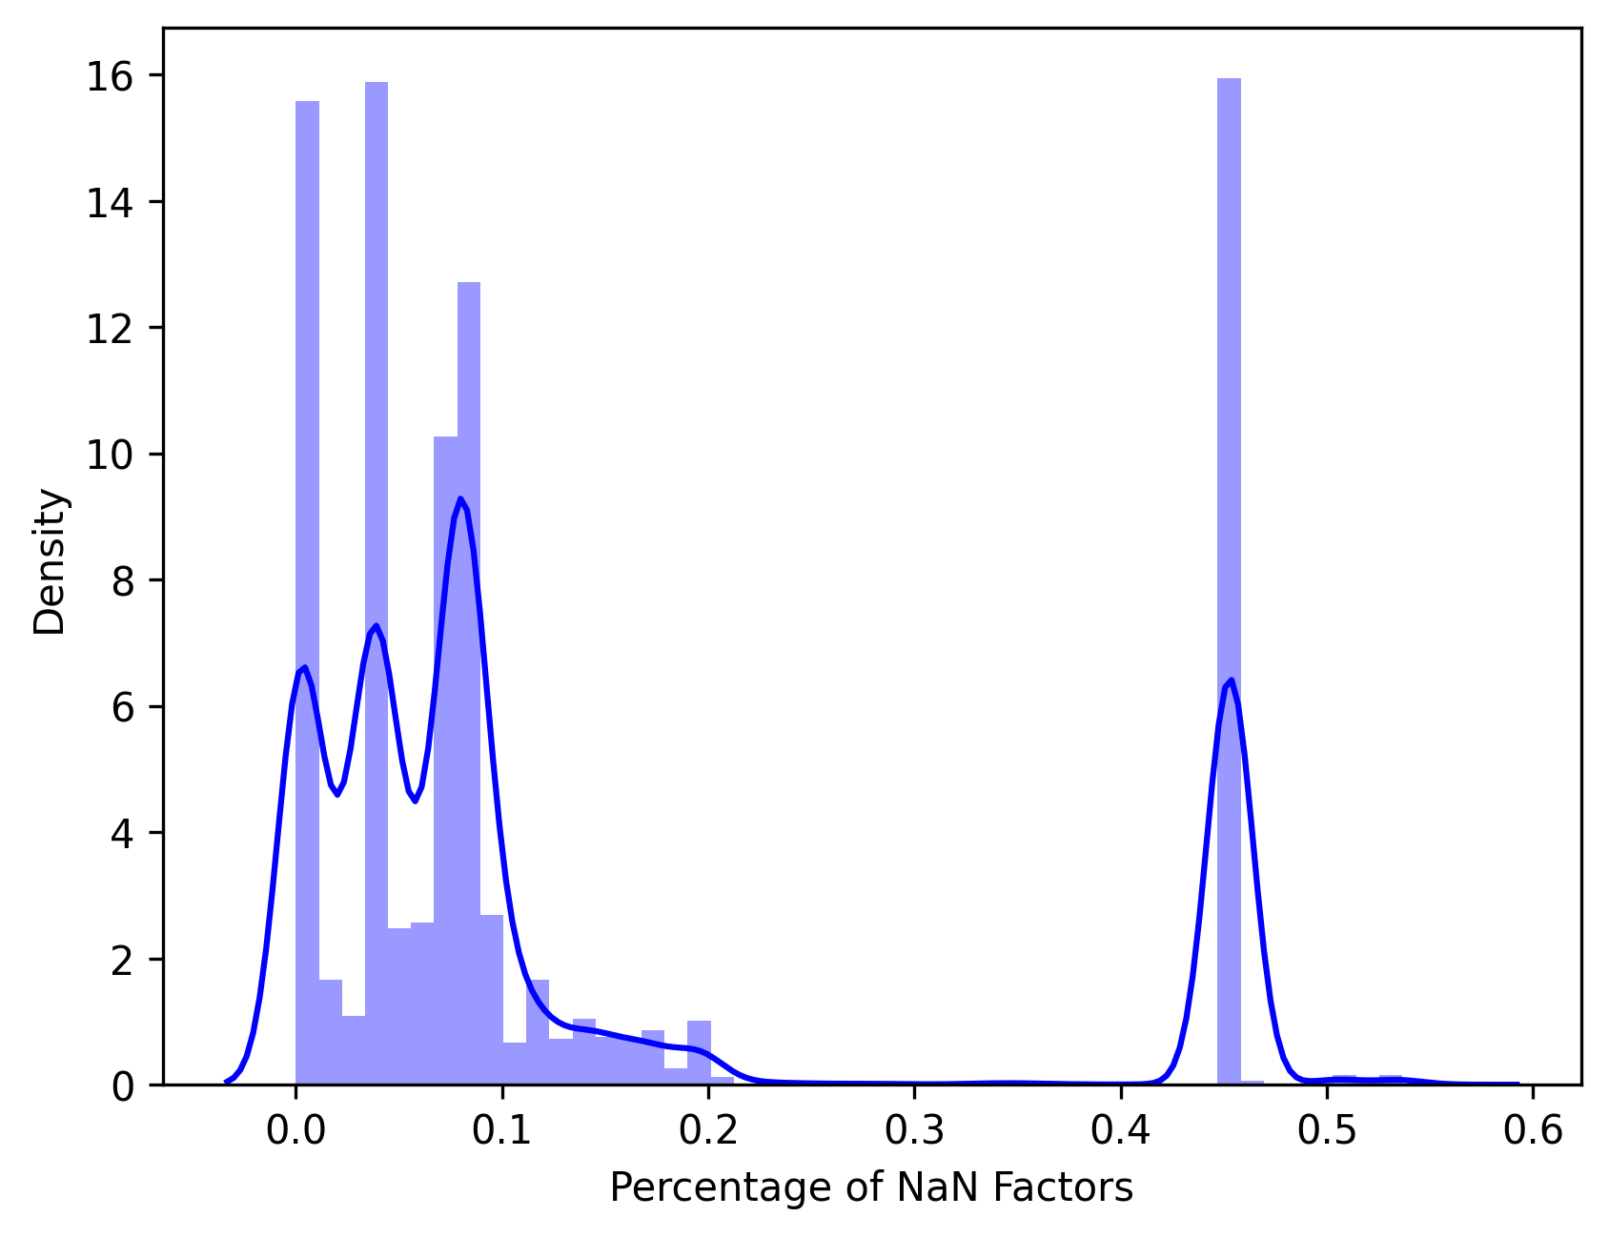
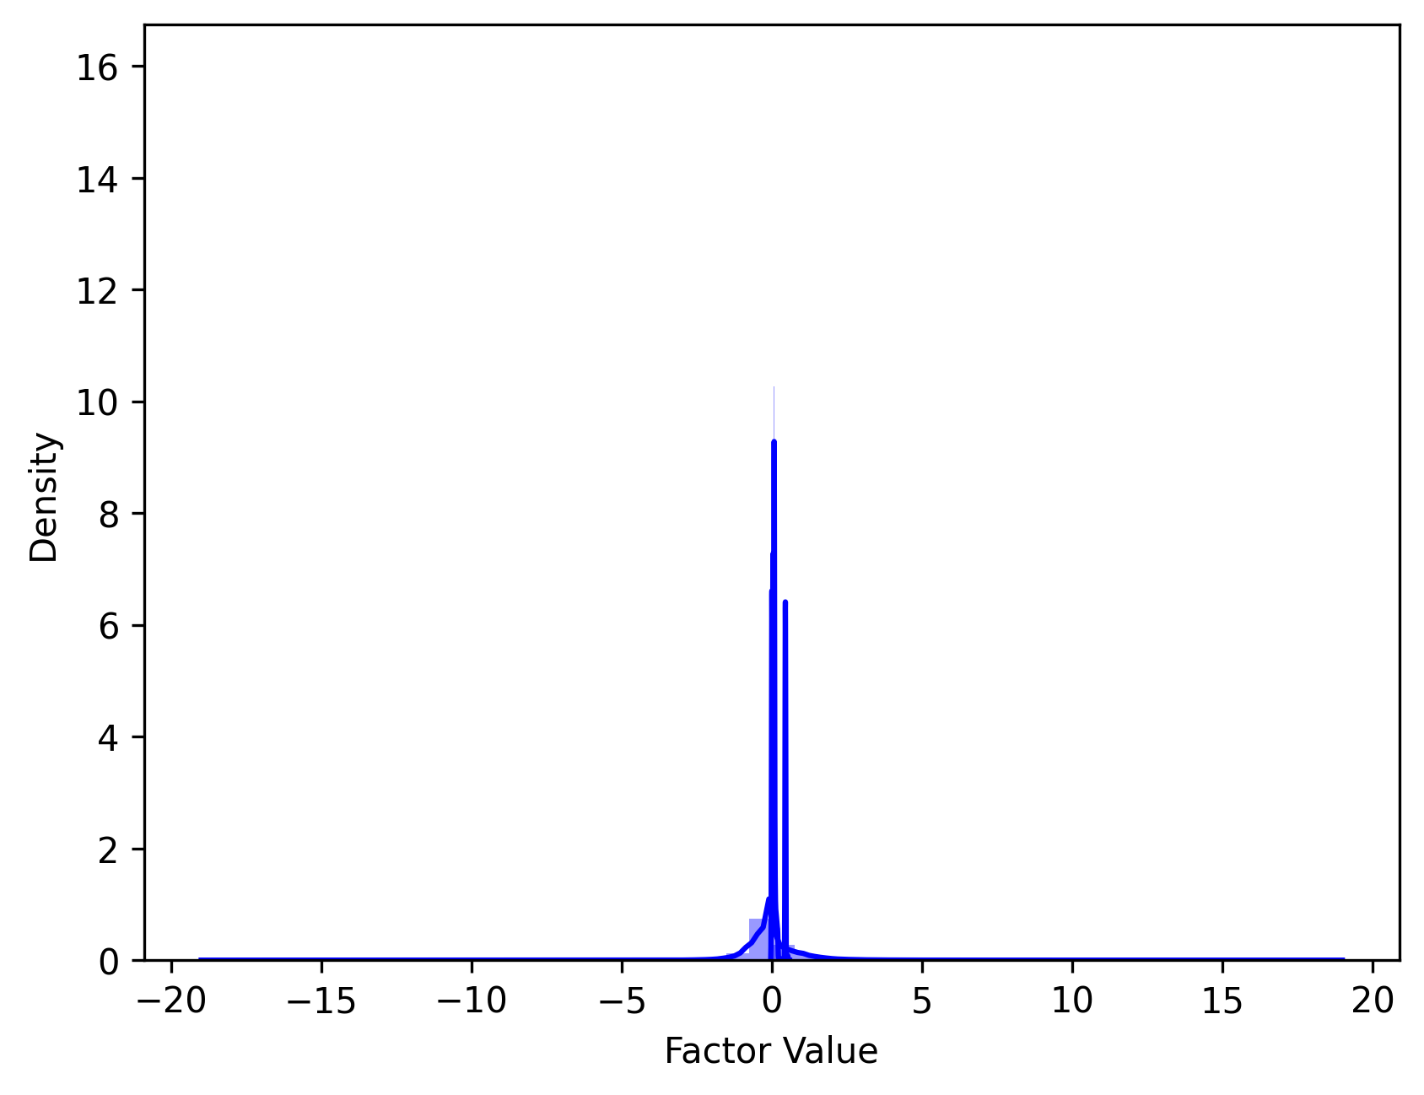
3.1 Select & Normalize
Raw Samples
(500 stocks, 606475 samples)
Samples have
NaN Label
Samples have too many NaN Factors
Slected Samples (Fill NaN by 0)
(360 stocks, 449765 samples)
Cross Sectional
Z-Score Normalization
Normed Samples
Fig 2. The Distribution of Nan Factors Percentage. We dropped samples where the percentage of NaN factors was greater than 10%.
Fig 3. The Select & Normalize Workflow. We also present the normed data distribution here.

Slide 4
3.2 In-Sample & Out-Sample Modeling
Normed
Factors
Daily Return
Label
Normed Samples
Train
Valid
Test
or
Discrete:
0-decrease; 1-no change; 2- increase
MSE Loss
CE Loss
Regression Modeling
Classification Modeling
Return Prediction
Discrete Prediction
All Samples to Train/Valid/Test
➸ In-Sample Modeling
Use Label to
Compute Metrics
Split to Train/Valid/Test
➸ Out-Sample Modeling
F1 Score & ACC
Fig 4. In-Sample and Out-Sample Modeling Framework.

Slide 5
3.2.1 In-Sample ”Perfect” Modeling Method
Normed Samples
Stock 1
Regression Model 1
100%
F1
& ACC
Both regression and classification models have a larger number of parameters than the training sample data.
They are theoretically able to memorize data !
Classification Model 1
Normed Samples
Stock 2
Regression Model 2
Classification Model 2
···
Normed Samples
Stock 360
Regression Model 360
Classification Model 360
Fig 5. Theoretically perfect way of In-Sample modeling.
Why there is no perfect ACC and F1 when use Regression Modeling ?

Slide 6
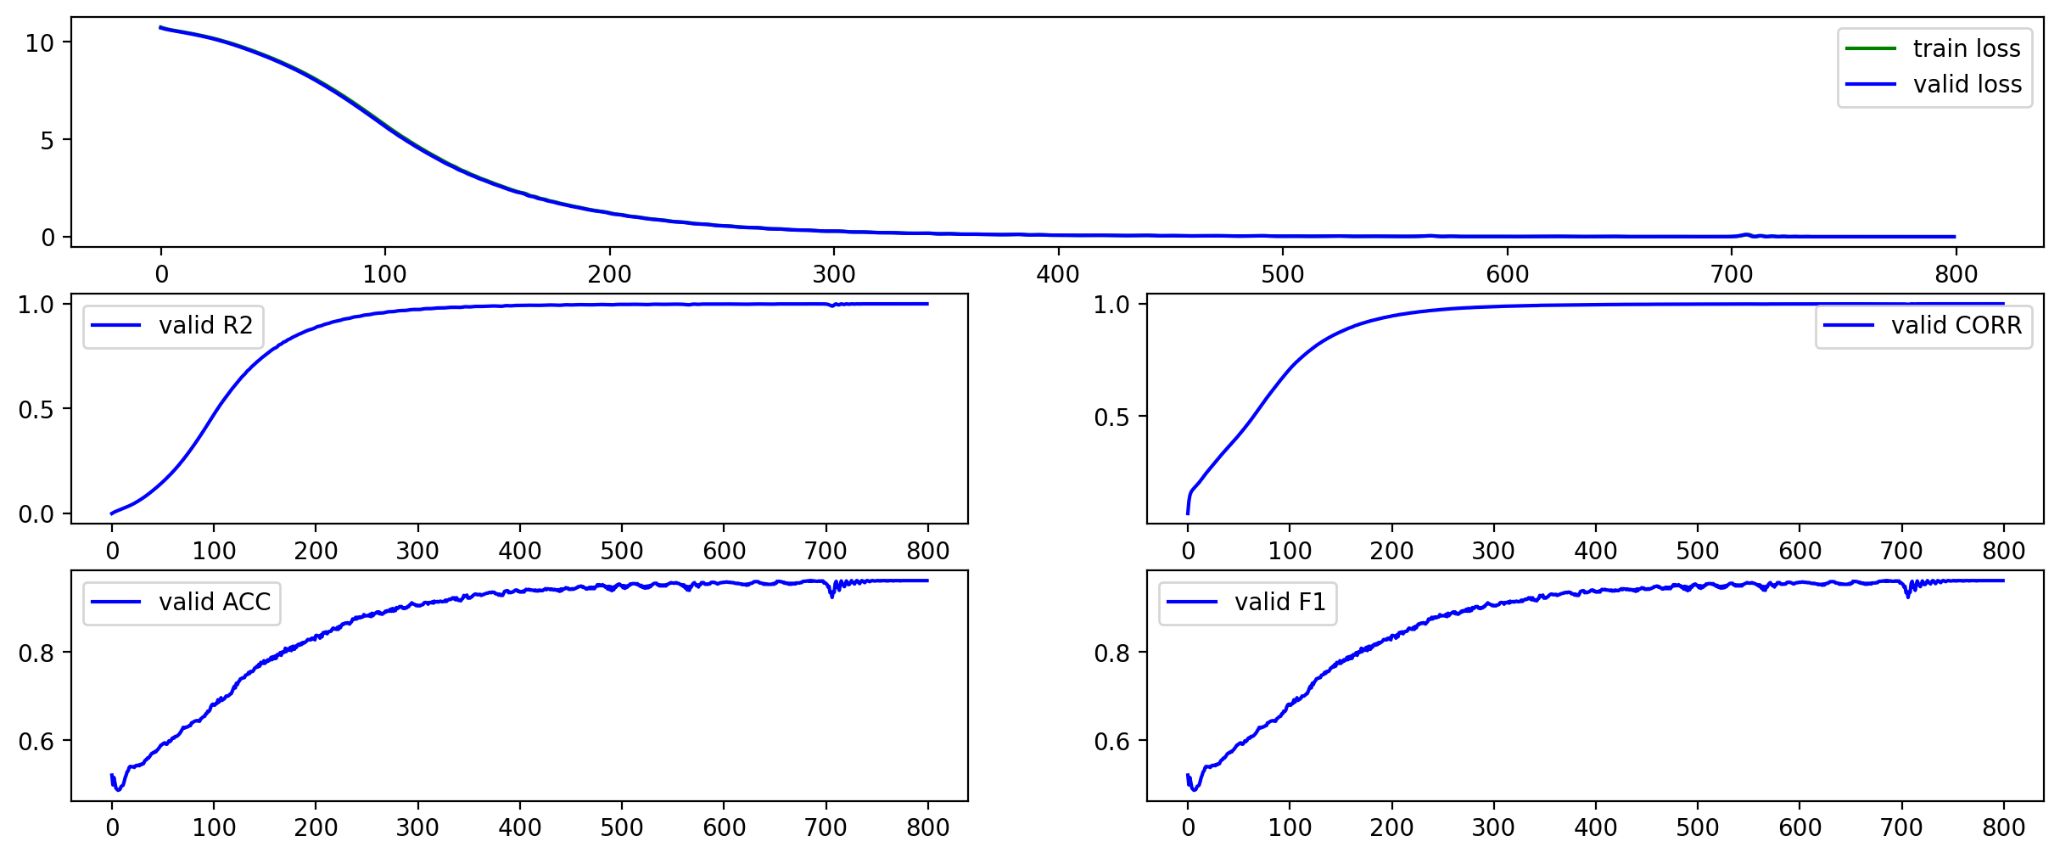
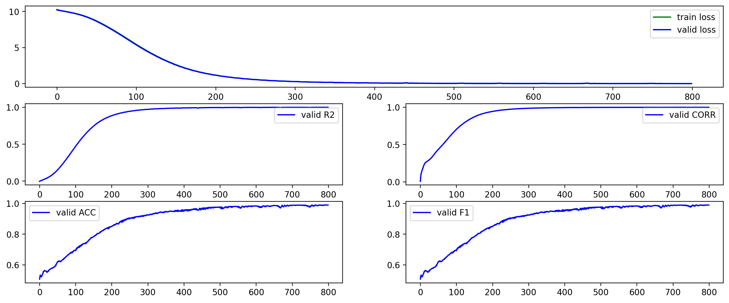
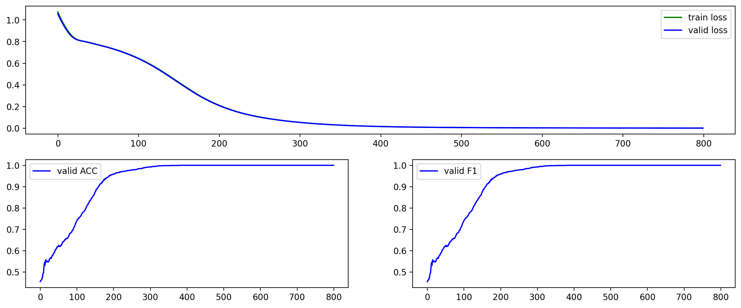
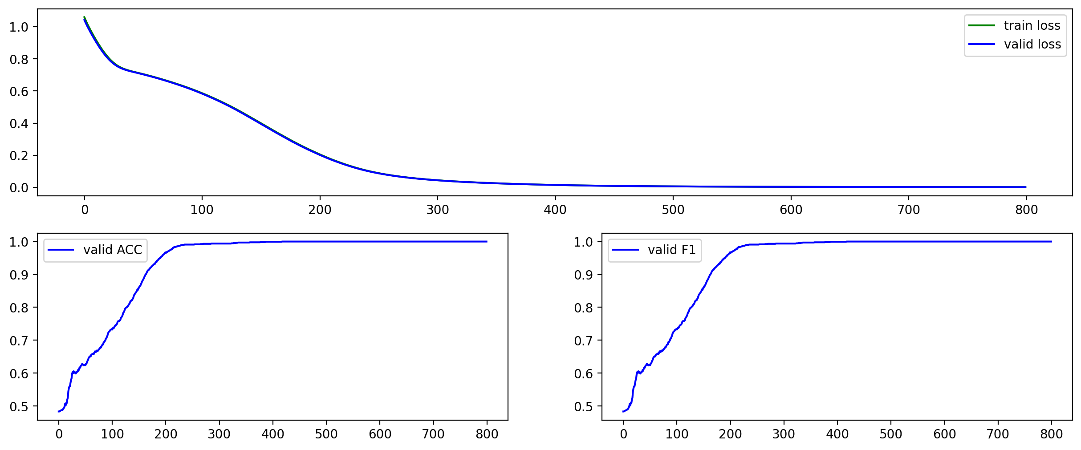
3.2.1 In-Sample ”Perfect” Modeling Result
000009.sz
000021.sz
Regression Modeling: ACC = 0.96, F1 = 0.96
Regression Modeling: ACC = 0.99, F1 = 0.99
Classification Modeling: ACC = 1.00, F1 = 1.00
Classification Modeling: ACC = 1.00, F1 = 1.00
Fig 5. In-Sample Modeling Result. We got the theoretically “perfect” result.
Why there is no perfect ACC and F1 when use Regression Modeling ?

Slide 7
3.2.1 In-Sample Overall Stocks Modeling Result

Slide 8
3.2.2 Out-Sample Stocks Modeling Progress

Slide 9
Text boxes – two columns of numbered points for each point
1
Bullet
Dash
Sub bullet
Bullet
Dash
Sub bullet
2
Bullet
Dash
Sub bullet
Bullet
Dash
Sub bullet
3
Bullet
Dash
Sub bullet
Bullet
Dash
Sub bullet
4
Bullet
Dash
Sub bullet
Bullet
Dash
Sub bullet
5
Bullet
Dash
Sub bullet
Bullet
Dash
Sub bullet

Slide 10
Text boxes – two columns of numbered points for each point
1
6
Bullet
Dash
Sub bullet
Bullet
Dash
Sub bullet
2
7
Bullet
Dash
Sub bullet
Bullet
Dash
Sub bullet
3
8
Bullet
Dash
Sub bullet
Bullet
Dash
Sub bullet
4
9
Bullet
Dash
Sub bullet
Bullet
Dash
Sub bullet
5
10
Bullet
Dash
Sub bullet
Bullet
Dash
Sub bullet

Slide 11
Text boxes – two ways of showing major points
Text
Text
Bullet
Bullet
Bullet
Bullet
Bullet
Bullet
Text
Bullet
Bullet
Bullet
Bullet
Bullet
Bullet
Text
Bullet
Bullet
Bullet
Bullet
Bullet
Bullet
Text
Bullet
Bullet
Bullet
Bullet
Bullet
Bullet

Slide 12
Text boxes – major points with chevrons
Text
Text
Bullet
Bullet
Bullet
Bullet
Bullet
Bullet
Text
Bullet
Bullet
Bullet
Bullet
Bullet
Bullet
Text
Bullet
Bullet
Bullet
Bullet
Bullet
Bullet
Text
Bullet
Bullet
Bullet
Bullet
Bullet
Bullet

Slide 13
Text boxes – chevrons with text boxes
Text
Text, Palatino Linotype14-pt bold
Text
Text
Text
Paragraph (if not needed, delete)
Bullet
Dash
Sub bullet
Paragraph (if not needed, delete)
Bullet
Dash
Sub bullet
Paragraph (if not needed, delete)
Bullet
Dash
Sub bullet
Paragraph (if not needed, delete)
Bullet
Dash
Sub bullet

Slide 14
Text boxes – vertical chevrons with text
Text
Bullet
Dash
Sub bullet
Text
Bullet
Dash
Sub bullet
Text
Bullet
Dash
Sub bullet
Text
Bullet
Dash
Sub bullet

Slide 15
Text blocks – two squares
Paragraph (if not needed, delete)
Bullet
Dash
Sub bullet
Paragraph (if not needed, delete)
Bullet
Dash
Sub bullet
15

Slide 16
Text blocks – sources leading to
Text
Text
Paragraph (if not needed, delete)
Bullet
Dash
Sub bullet
Paragraph (if not needed, delete)
Bullet
Dash
Sub bullet
Text

Slide 17
Logic trees – executive summary tree
Report title
Main conclusion
Chapter title
Chapter title
Chapter title
Chapter title
Supporting conclusion
Supporting conclusion
Supporting conclusion
Supporting conclusion
Slide text
Dash
Slide text
Dash
Slide text
Dash
Slide text
Dash

Slide 18
Steps – two
Growth Path
Step 2 (if not needed, delete)
Bullet
Dash
Sub bullet
Step 1 (if not needed, delete)
Bullet
Dash
Sub bullet
xxx | Content Dash | Content Dash
xxx | Content Dash | Content Dash

Slide 19
Steps – three
Growth Path
Step 3 (if not needed, delete)
Bullet
Dash
Sub bullet
Step 2 (if not needed, delete)
Bullet
Dash
Sub bullet
Step 1 (if not needed, delete)
Bullet
Dash
Sub bullet
xxx | Content Dash | Content Dash | Content Dash
xxx | Content Dash | Content Dash | Content Dash

